Slide 1


TraffEye
Smart Traffic Violation Detection & Reporting System
Harnessing artificial intelligence to revolutionise road safety and enforcement in urban India

Slide 2




Traffic Violations on roads
Rampant Violations
Overwhelmed Enforcement
Urgent Need
Frequent helmetless riding, wrong-side driving, and signal jumping endanger lives daily across Kengeri and Global Village
Manual enforcement struggles with thousands of violations going unchecked, worsening congestion and accident rates
A scalable, real-time, and accurate detection system is essential to improve road safety and compliance

Slide 3
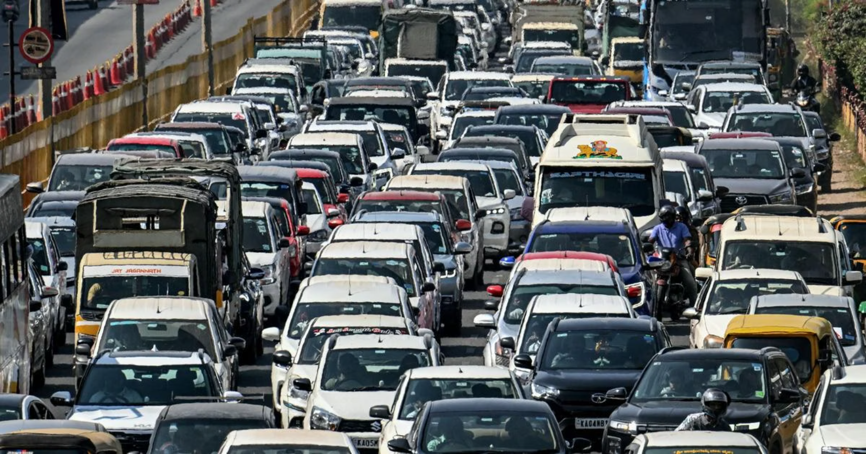
AI-Powered Smart Enforcement
Intelligent Detection
Advanced AI cameras with computer vision identify helmet violations, wrong-side driving, signal jumping, and more in real-time
01
02
03
Real-Time Capture
Automated Challans
Centralised Dashboard
Violations captured with geo-tagged, time-stamped digital evidence ensuring complete legal validity
E-challan generation and direct mobile notifications to offenders streamline the entire enforcement process
Integration with traffic authority dashboards enables swift monitoring, analysis, and decisive action

Slide 4
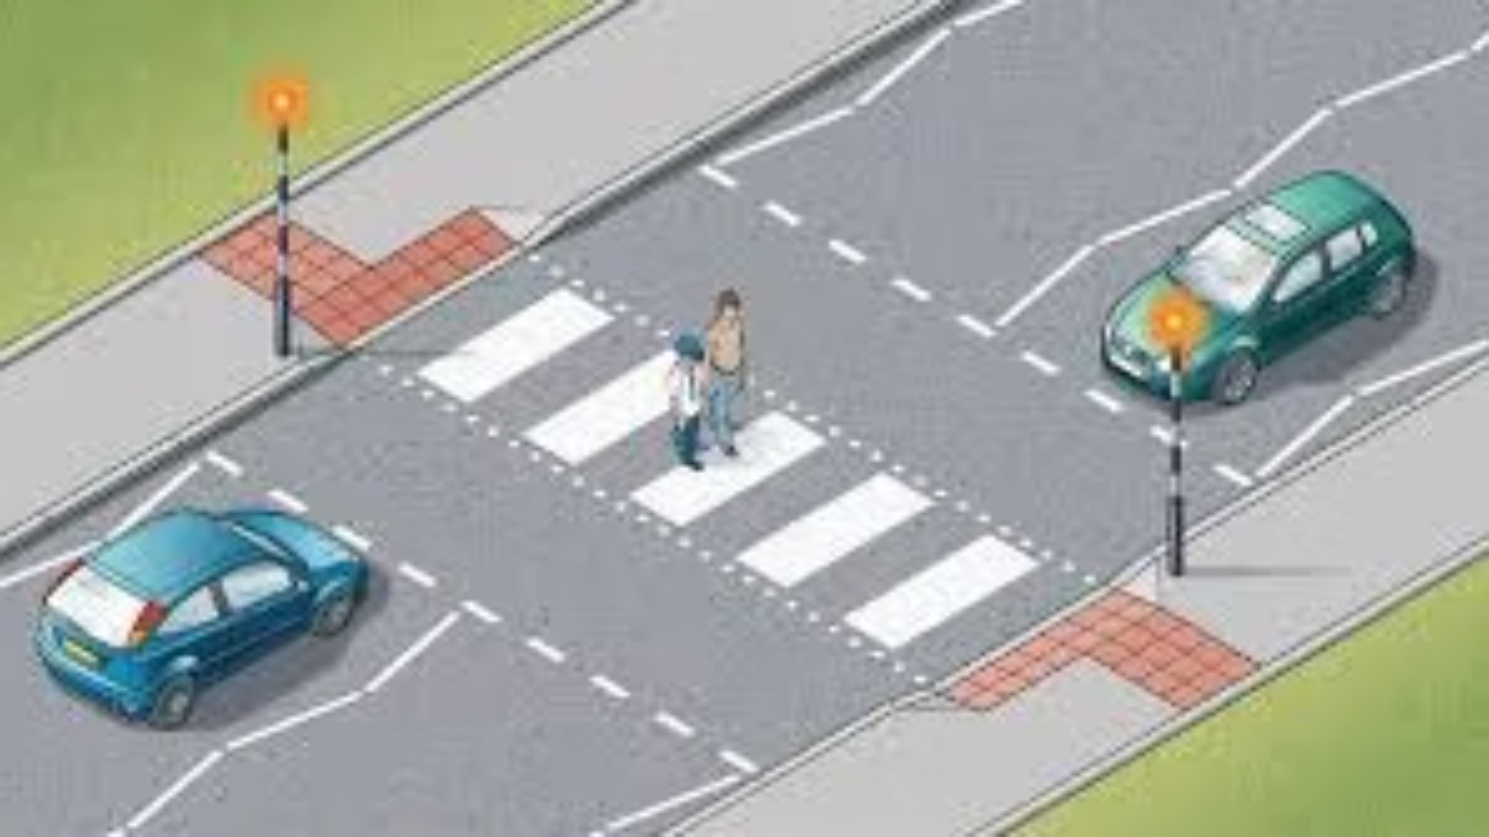



Safer Streets with TraffEye
Empower Enforcement
Scalable, accurate, and automated violation detection for law enforcement agencies
Build Awareness
Enhance public compliance through transparent, timely reporting and education
Save Lives
Reduce accidents, congestion, and fatalities

Slide 5
THANK YOU

